Slide 1

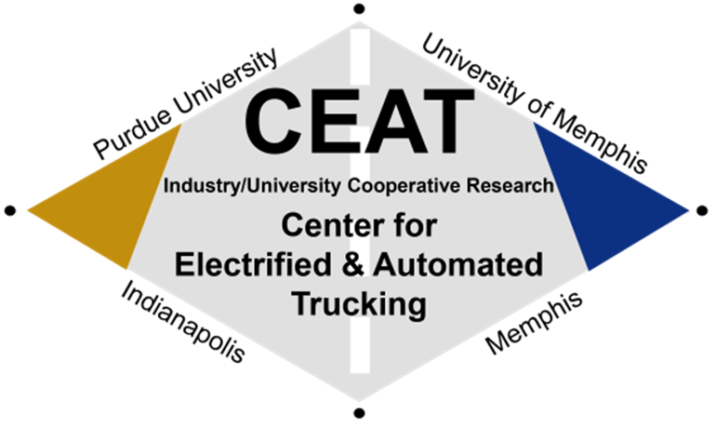
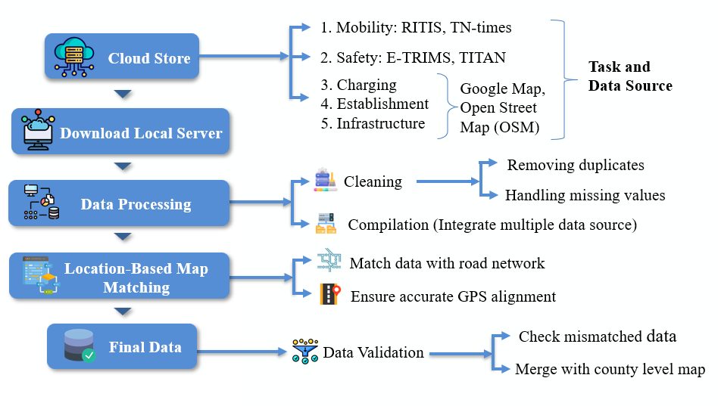
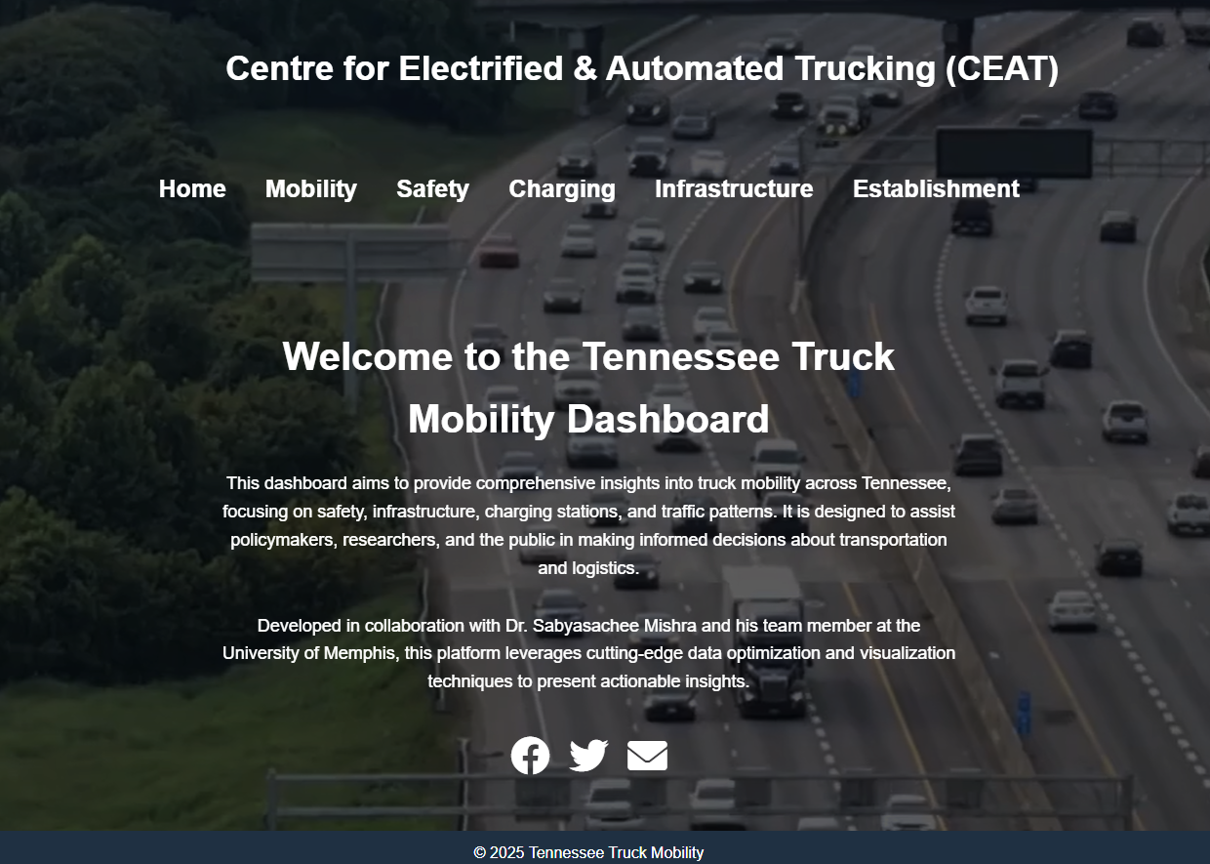
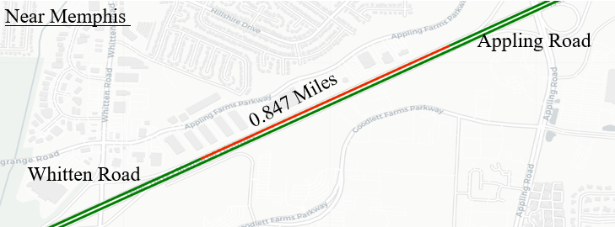
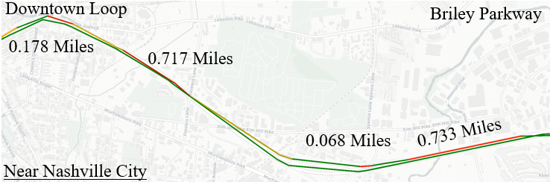
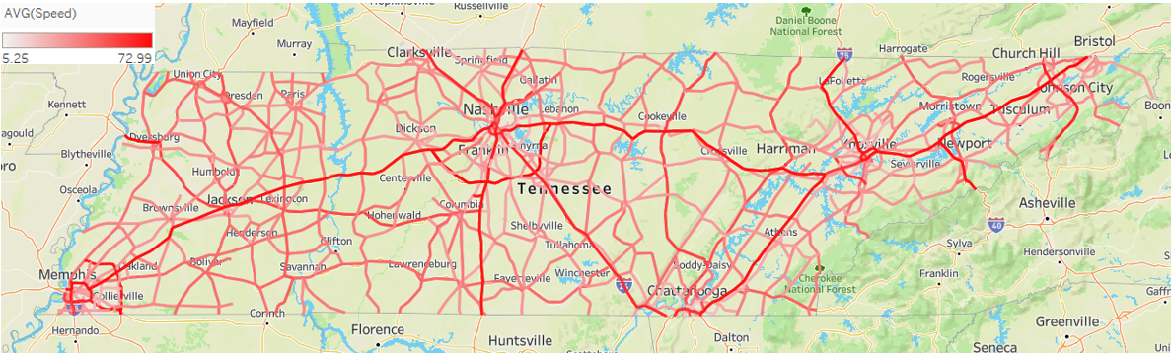
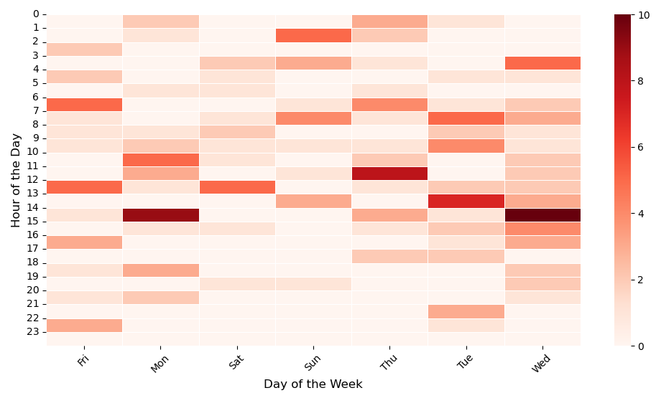
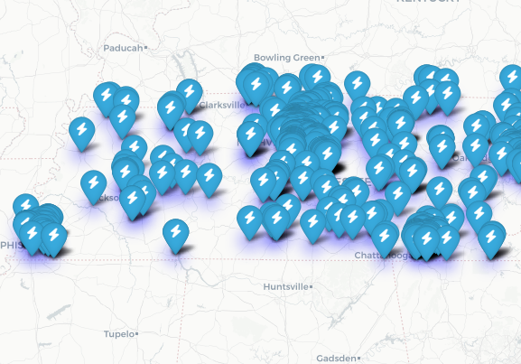
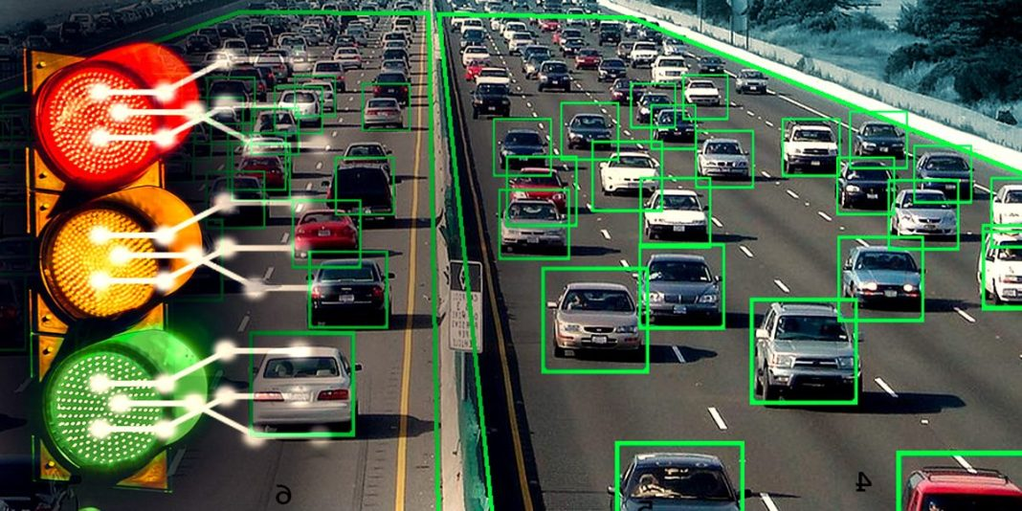
Comprehensive Mobility Dashboard for the Trucking Sector
IUCRC Phase 1, Year 1
Dr. Sabya Mishra (PI), Md Tawkir Ahmed (Student)
Efficient freight transport is key to economic sustainability, but truck crashes and congestion hinder mobility and safety. This study identifies high-risk areas on interstates and highways, highlighting speed variations and intersection-related crashes. Strategies like adaptive signals, truck-priority lanes, and dynamic routing can enhance mobility and reduce crash risks, improving freight efficiency and road safety.
Multi source data collection, integration and trend analysis.
Build data driven real-time models for traffic monitoring.
Develop interactive dashboard and software.
Evaluate existing road networks and generate report.
Objectives
Methodology
Dashboard
Congestion
Speed Heatmap
Spatiotemporal Truck Crash
EV Charging Stations for Truck
Data Driven Method

